Slide 1

Brand Blueprint

Slide 2
XO SKIN- Brand blueprint
^{The Story So Far}
XO SKIN is brand that is currently under development and must deliver hard results.
From the very beginning in 2006, the brand has always reflected a spirit of discovery and adventure, bringing an eclectic yet technically advanced – mix of products together from around ^{the world.}
This document sets out a compelling and consistent vision for the brand that will propel it forward into its next exciting chapter ^{of growth.}

Slide 3
XO SKIN- Brand blueprint
Challenges to overcome
To realise our growth ambitions, there are several challenges ^{we need to overcome:}
1 Clarify what we stand for and how we want our customers to feel about us. What is our core brand message? Where will we be positioned in the market? Who are our competitors? Are we a beauty care or lifestyle brand? How premium should we be?
2 Ensure our product portfolio is competitive and relevant to ^{our customers}
3 Define a consistent, outstanding in ^{e-store and product experience} ^{to delight our customers}
4 Recruit the next generation of customers to support ^{and grow our growth base}
Confidential-IP of XO SKIN LLC

Slide 4
XO SKIN- Brand blueprint
Business opportunity
We have ambitious plans for XO SKIN. To meet our growth targets over the next three years we need to:
1 Establish & increase share in our proposed core categories: facial care, hands, feet, colour cosmetics
2 Enter the two of the largest beauty care categories: skincare, and colour cosmetics
The blue circles in the chart on the next page show where XO SKIN intends to operate. The objective in this case is to increase share and profitability from these categories.
The white circles are categories in which we don’t currently operate. It’s crucial we enter these new categories in order to meet our growth ambitions and remain competitive with our peer group. We outline later how we’ll achieve this.
Confidential-IP of XO SKIN LLC

Slide 5
XO SKIN- Brand blueprint
Competitive Intensity
Skincare
$66bn
Haircare
$49bn
Colour
cosmetics
$40bn
Fragrances
$32bn
Soap, bath
& Shower
$40bn
Replace with Sports Lines
Barriers to Entry
Confidential-IP of XO SKIN LLC

Slide 6
XO SKIN- Brand blueprintand blueprint
^{Our target consumer}
Who doesn’t want to feel and look better?
These are the primary motivations across all beauty care categories. People are looking for products that work.
But how can we stand out in this market? And how can we target the customers who will delight in our emotive, aspirational products?
We have three core groups of customers, detailed on the next page.
Confidential-IP of XO SKIN LLC

Slide 7
XO SKIN- Brand blueprint
Consumer targets
^{Simply the Best} These customers search out the best possible products to help them feel and look better. Quality and experience are crucial for this group. They’re prepared to spend what they need to ensure they have the very best – and they’ll explore new products and rituals in the pursuit of this.
^{Shelf Stalkers} These customers are looking for information about products to reassure them about quality. They want to be informed (and delighted) by product details and stories which make a connection with them. Combined with “Simply the best”, these two segments cover 46% of the beauty market and represent a significant opportunity for Crabtree & Evelyn.
^{Habitual Shoppers} Our third group of customers (bringing the total to 68% of the market) are shoppers who regularly go to the same place. They’re a secondary target for us because they will be acquired over time as new customers are brought into the brand and our presence grows.
Confidential-IP of XO SKIN LLC

Slide 8
XO SKIN- Brand blueprint
Groups to discount
^{Individualists} These customers have limited income and see beauty care products as a non-essential purchase. They’re bargain hunters who like to shop around for new deals. Because of this, we won’t be targeting this group. ^{Conformists} This group is predominantly young (16-25 years) and buys mass market products. They’re entrenched in their behaviour, so we won’t be focusing on them.
Confidential-IP of XO SKIN LLC

Slide 9
XO SKIN- Brand blueprint
Target segments plan
Confidential-IP of XO SKIN LLC

Slide 10
XO SKIN- Brand blueprint
^{Our products}
We are a beauty care brand. But at the heart of all our products is Face Therapy: our number one selling product, and icon of the brand on which to build.
We should take great care in out packaging concepts. Consider paint tubes or mini pumps for our Face Therapy.
Our products should also represent the spirit of adventure (in terms of ingredients) and everyday quality so important to our brand. Face care is part of a daily routine – and for many, it forms an important ritual in their daily lives.
Confidential-IP of XO SKIN LLC

Slide 11
XO SKIN- Brand blueprint
^{The role of rituals}
Creating a delightful, memorable experience is essential for us. So we think of our products within the notion of ritual – much more sensual, richer and more enjoyable than a routine. This will become a well-understood point of difference for our brand in due course.
Our rituals will evolve over time, as seasons change and new trends emerge – providing us with ample opportunity to surprise and delight our customers, every day.
Confidential-IP of XO SKIN LLC

Slide 12
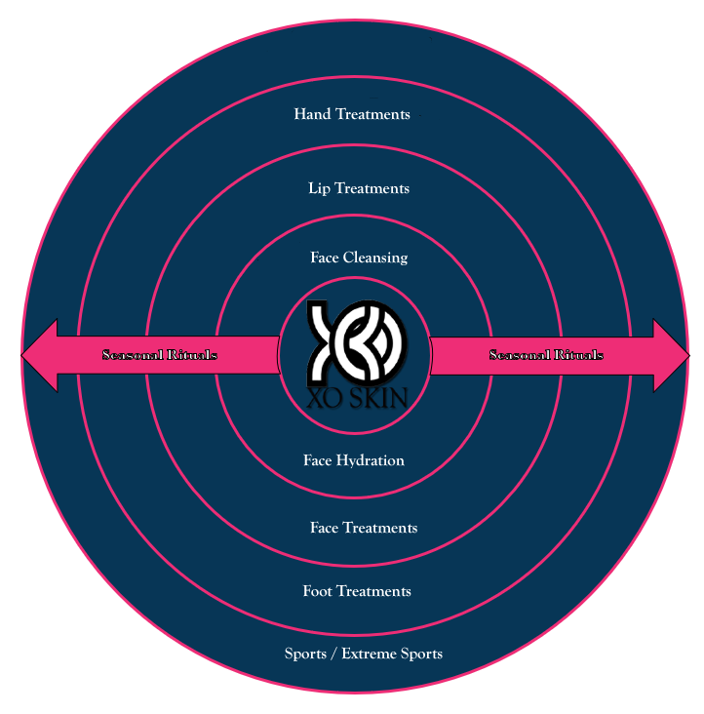
XO SKIN- Brand blueprint
Creating a strategy for diversification
Our core product icon is Face Therapy, from which all other products grow, step-by-step. Seasonal rituals are important here to excite customers and make sure we’re always relevant to their needs.
Confidential-IP of XO SKIN LLC

Slide 13
XO SKIN- Brand blueprint
^{The brand}
Confidential-IP of XO SKIN LLC

Slide 14
XO SKIN- Brand blueprint
Our brand positioning
We aim to delight our customers every day with high-quality Skin care products and rituals.
Our brand must:
1 Signal a change in direction
2 Enable us to succeed in Skin care
Attract all genders, all skin types
Educate
Confidential-IP of XO SKIN LLC

Slide 15
XO SKIN- Brand blueprint
Brand belief:
Love the Skin you’re In!
Everything is a Choice !
Confidential-IP of XO SKIN LLC

Slide 16
XO SKIN- Brand blueprint
Brand positioning: the who, what, how & why
From the very beginning we’ve travelled the globe in search of inspiration, efficacious and unusual ingredients for our Skin care products. But our fascination for the extraordinary and eclectic doesn’t end there.
We draw on the finest ingredients, expertise and treatments from around the world to bring you delightful Skin care products and rituals influenced by nature – and deliver these to you with our unique innovative style and creative flair.
So whether you want to look good or feel better in yourself, allow us to take you on a journey of discovery – one that will make a world of difference.

Slide 17
XO SKIN- Brand blueprint
Brand promise
Everything is a Choice!
Our brand promise is the heart of our brand. It’s what we deliver to our customers every time they come into contact with us – from our website to our stores – every single day. But it’s just as relevant inside our business as it is outside, so it helps us ensure our customers, our teams and retailers experience the same, distinctive XO Skin.
Confidential-IP of XO SKIN LLC

Slide 18
XO SKIN- Brand blueprint
Our brand values
Our values define our personality as a brand, as well as our behaviour. Everything we do should be judged against our values and promise in combination. We should ask ourselves: are we delivering a the difference that it takes in an effective, delightful and original way? Are we supporting your Choice?
Rational Effective Quality performance, relevant and good for you
Emotional Delightful A beautiful, surprising and sensory experience
Aspirational Original Unique, eclectic and hungry to find a better way
Confidential-IP of XO SKIN LLC

Slide 19
XO SKIN- Brand blueprint
^{Creative vision}
Confidential-IP of XO SKIN LLC

Slide 20
Crabtree & Evelyn - Brand blueprint
The Creative Vision
The way we bring our brand to life is essential in helping us achieve our aims as a business. We know that Everything is a Choice. We need to build value into the brand identity as a whole; by using the visual elements and tone of voice clearly and consistently we will create an instantly recognisable brand filled with meaning.
This section and the next (on tone of voice) sets out the basic elements of the XO SKIN brand – setting the creative vision which needs to be reflected in every part of the customer journey, from e-store, environments, to packaging, delivery, and the expectation of your choice.
Confidential-IP of XO SKIN LLC

